Slide 1

Introducing
Honorlock
Advancing Assessment Proctoring with Integrity
Notes:
[Institution Name] is partnering with Honorlock to proctor exams. We’ll walk you through who they are and what makes them unique. Let’s dive in

Slide 2

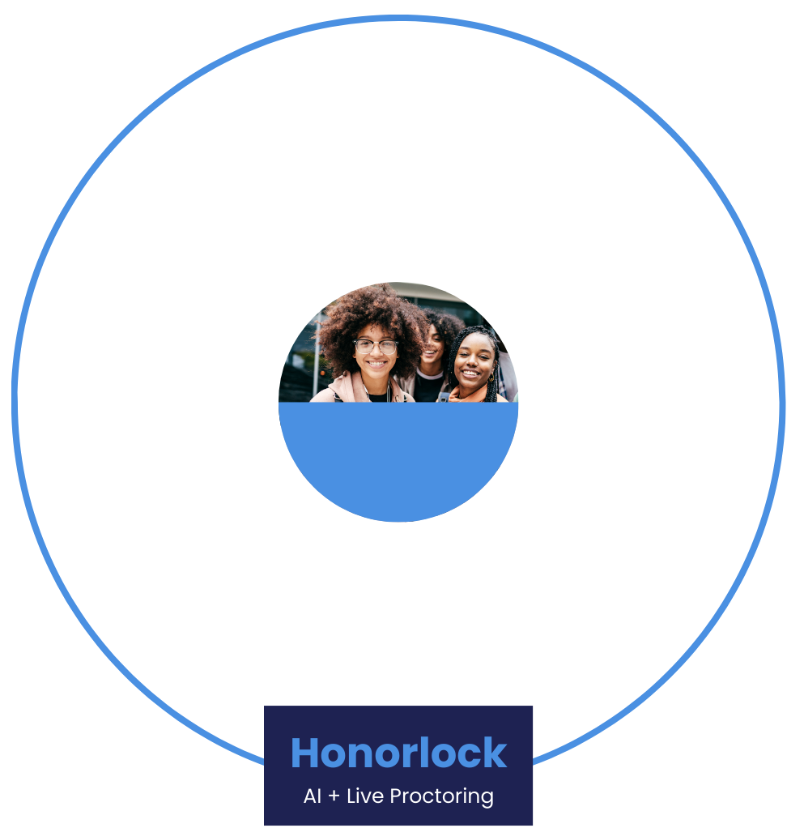
Redefine Integrity
For Today’s Needs
Institutions
Honorlock goes beyond catching cheating and considers the entire testing experience.
Students
Faculty
Honorlock
AI+Live Proctors
AI + Live Proctors
Confidential | © 2026 Honorlock
Notes:
Honorlock puts support and the human experience at the forefront of they do from design to innovation. The result is the perfect balance of AI and live proctoring.
They let AI do the heavy lifting and handle exam entrance, environment control, flag what their live proctors need to pay attention to - review and dismiss what they can. Their live proctors review exam sessions with great care and only intervene when necessary creating low friction and a great experience for our students.

Slide 3

SECTION NAME
AI Generated Flags
How Honorlock’s Live Pop-In™ Works
Proctor Evaluation
Window
Live Pop-In
AI monitors exams, and a remote proctor only intervenes when necessary, creating a less stressful testing experience that reduces anxiety.
Proctored-Added Violations
Faculty Email Notification
Confidential | © 2026 Honorlock
Confidential | © 2026 Honorlock
Notes:
Honorlock is live proctoring augmented by AI. Honorlock is effective at deterring cheating, reducing test anxiety, and remediating leaked test content.
How Honorlock Live Pop-in Works:
AI generates flags based on prohibited behaviors
Proctors pop-in, only when necessary
It proctors notice clear exam misconduct, they add a “violation”, which appears in the session viewer
Faculty are alerted when a “Violation” has occurred

Slide 4

Designed to Protect Integrity
Proctor exams online with a comprehensive solution that supports test takers, detects cell phones, locks the browser, blocks AI, and everything in between.
Finds Leaked Content
Search & Destroy™ identifies compromised exam questions and offers simple steps to protect integrity
Detects Devices
Detects when students use a secondary device, such as a cell phone, through a comprehensive detection toolkit
Secures the Browser
BrowserGuard™ prevents and flags access to unauthorized websites and apps
Verifies Identity
Authenticates identity to ensure the person taking the test is the same as the person earning the degree
Blocks AI Tools
The Honorlock Application blocks the use of invisible AI tools, like Cluely, to prevent dishonesty before it starts
Captures Exams From Every Angle
Side camera view helps reduce blind spots and gives you more context when questions about exam integrity arise
Confidential | © 2026 Honorlock
Notes:
Honorlock is designed to prevent student testing misconduct, protect our intellectual property, secure test content, and prevent exam content leaks. Here are a few of the top exam security features:
Search & Destroy™ - Identifies compromised exam questions and offers simple steps to protect integrity
BrowserGuard™ - Prevents and flags access to unauthorized websites and applications, resizing the exam screen, and using keyboard shortcuts and functions and records the desktop for the duration of the exam
Cell Phone Detection - Detects when students try to search test questions during exams using a secondary device, such as a cell phone; then the proctor validates and clearly marks the violation
Blocks AI tools and extensions - The Honorlock Application blocks any extensions running in the background of exams, prevents copy/paste, and secures the browser
Verifies student identity - Authenticates identity to ensure the person taking the test is the same as the person earning the degree
Captures Exams From Every Angle - Side camera view helps reduce blind spots and gives you more context when questions about exam integrity arise

Slide 5

Support That Drives Student Success & Confidence
Live Support 24/7/365
No Exam Scheduling
Certified Proctors
Reduced Test Anxiety
HonorPrepTM
14M
Proctored Exams
in 2025
15s
Average Support
Response Time
99%
Resolution in
First Contact
Confidential | © 2026 Honorlock
Notes:
Honorlock offers 24/7/365 support for all end-users— faculty and students alike. This eliminates the burden of support for proctoring from our help desks, and provides nearly immediate support for students and faculty.
Honorlock was founded by students, so the student experience has always been their top priority. They continually innovates to not only meet our institutional needs, but also to ensure a positive faculty and student experience. Here are a few ways they support the student experience:
Flexible exams windows allow students to test at a day and time that works best for them
Honorlock’s support team has an average chat wait time of just 5 seconds, a 94% chat satisfaction rating, and 97% of chats are from students
Their proctors undergo an extensive 80 hour training on DEI issues, mindfulness, becoming trauma-informed, and de-escalation strategies, ensuring they are equipped to handle any situation that may arise
HonorPrep is a step-by-step walk through that Students can access anytime via the LMS

Slide 6
Two Applications, Distinct Purposes
Mobile Application
Desktop Application
Serves as an optional, multi-use tool that allows students to use their smartphones for authentication, payment, workspace scans, and/or as a side-angle camera.
It streamlines the exam experience and gives faculty enhanced visibility without requiring complex hardware setups.
Extends security beyond the web browser to the entire device, blocking unauthorized external apps, screen sharing, virtual machines, unauthorized exam assistants like Cluely, and desktop AI tools.
Its enabled at the exam level—giving faculty the flexibility to require it for high-stakes midterms and finals while keeping it off for routine quizzes.
Confidential | © 2026 Honorlock

Slide 7

Side-Angle Camera Option
Provides a wider view of the student's physical workspace. This feature is recommended for assessments such as Math or Chemistry, where students must show hand-written work or utilize physical scratch paper.
Did you know?
Students can use either an external webcam or a smartphone via the Honorlock Mobile App.
Confidential | © 2026 Honorlock

Slide 8
The Benefit
It protects student privacy by focusing strictly on the desk area and ensures that proctors and faculty receive a clear, high-quality view on the first try, preventing unnecessary re-scans.
Workspace Scan
Standardizes the pre-exam environment check through a guided, mobile-first workflow that replaces inconsistent 360° room scans.
Confidential | © 2026 Honorlock

Slide 9
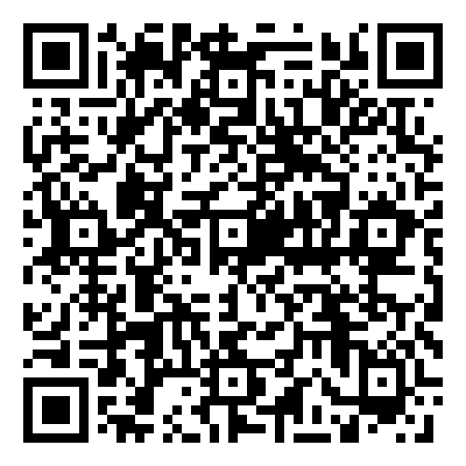
SECTION NAME
Honorlock’s Accessibility-First Approach
Accessibility Checklist | Yes
Is Honorlock full ADA compliant? | ✔
Does Honorlock support and integrate with assistive technology? | ✔
Does Honorlock have an updated Voluntary Product Accessibility Template? | ✔
Are instructors able to provide accommodations for specific students? | ✔
The right approach can improve accessibility for all students. See how Honorlock aims for genuine accessibility for all users.
Confidential | © 2026 Honorlock
Confidential | © 2026 Honorlock

Slide 10


Building a Culture of Integrity Together
Faculty Resources
Student Resources
Getting Started Guide
24/7/365 User Support
Upcoming Webinars
Honorlock Status Page
Newsletter Registration
Student Hub
HonorPrepTM
Top FAQs
Quick Fixes
System Check
Confidential | © 2026 Honorlock

Slide 11

Empower Your Teams to Maximize Honorlock
Email Templates
Social Templates
Honorlock Page
Circulate Honorlock resources with faculty and instructional designers
Share tips and tricks easily across any community, portal, or social platform
A one stop shop for all faculty and student resources hosted by the institution
Confidential | © 2026 Honorlock
Notes:
We want to ensure out users understand how to best leverage Honorlock. Honorlock provides an Adoption Toolkit with resources we can share out with faculty. The toolkit includes:
Customizable email templates
Social templates that can be used across different social platforms
Best practices for creating our own Honorlock page

Slide 12
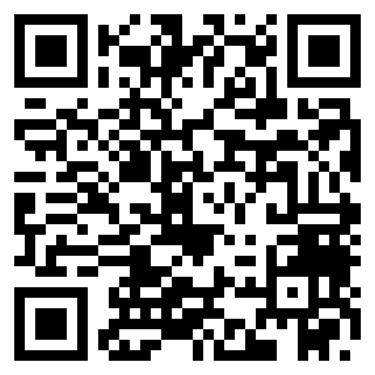
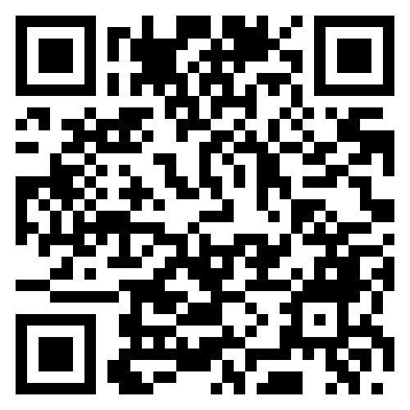
Follow us on LinkedIn
Stay Informed
Keep up with our latest events, updates, and resources.
Receive our quarterly newsletter
Confidential | © 2026 Honorlock

Slide 13
Thank you!

