Slide 1
Introducing
Honorlock
Advancing assessment proctoring with integrity, humanity and trust
Notes:
[Institution Name] is partnering with Honorlock to proctor exams. We’ll walk you through who they are and what makes them unique. Let’s dive in

Slide 2
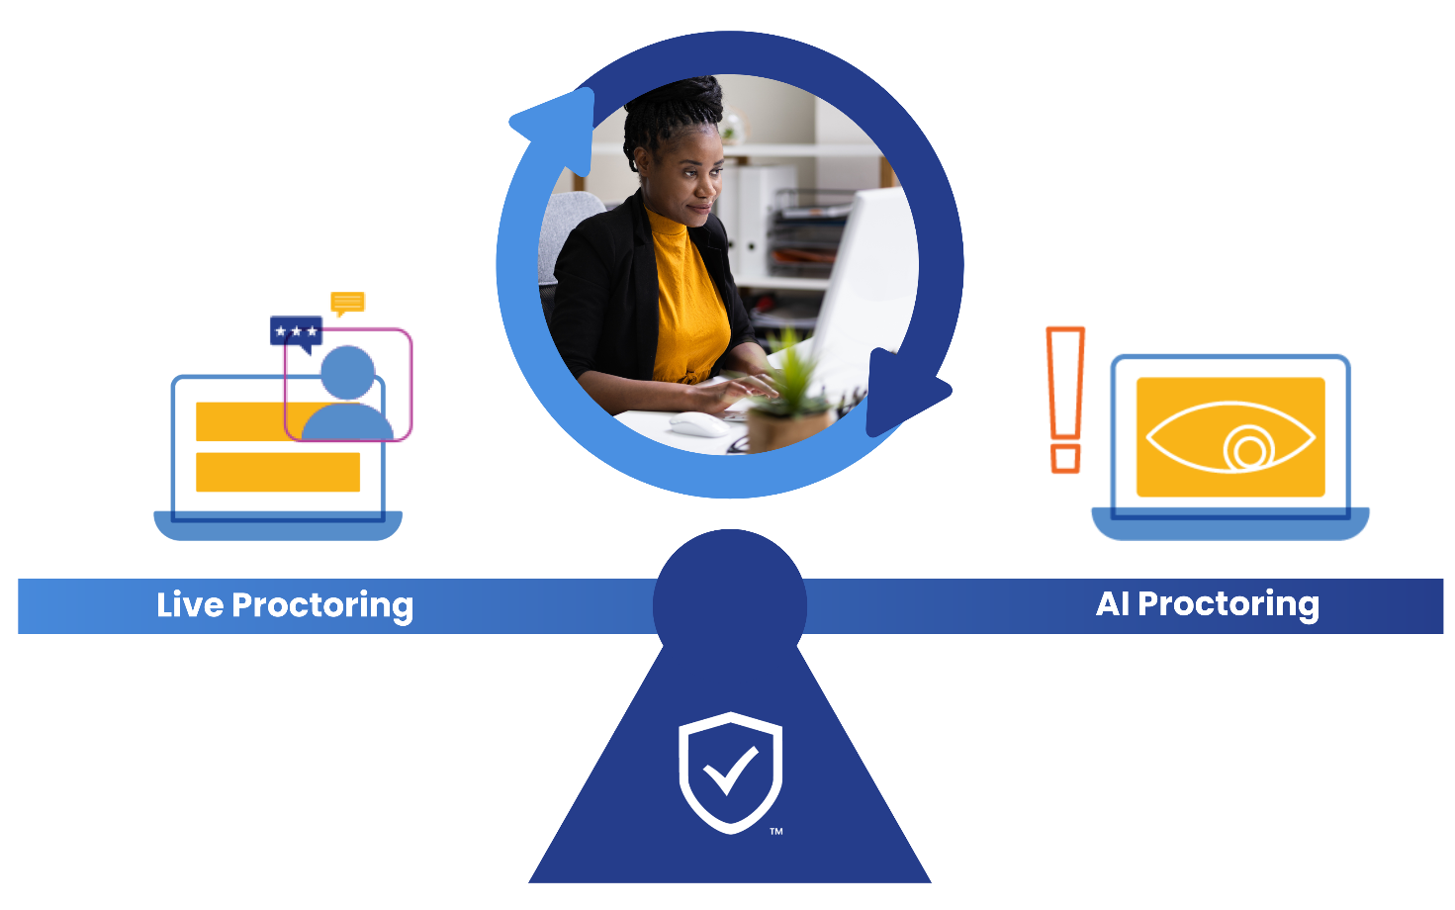
Best of Both Worlds.
Live Proctoring, Enhanced by AI
Notes:
Honorlock puts support and the human experience at the forefront of they do from design to innovation. The result is the perfect balance of AI and live proctoring.
They let AI do the heavy lifting and handle exam entrance, environment control, flag what their live proctors need to pay attention to - review and dismiss what they can. Their live proctors review exam sessions with great care and only intervene when necessary creating low friction and a great experience for our students.

Slide 3




The Honorlock Difference
Honorlock’s proctoring service saves instructor time, protects institution reputation, and fosters student success.
Deter & Prevent Academic Dishonesty
Reduce Test Anxiety
Remediate Leaked Test Content
Notes:
Honorlock is live proctoring augmented by AI. Honorlock is effective at deterring cheating, reducing test anxiety, and remediating leaked test content.
Their goals are to:
Protect the integrity of our institution, out students, and the intellectual property of our content and the exams themselves
Drive a human-centric, person-to-person communication at all levels including our students, faculty, and leadership
Creates a non-invasive and equitable environment for testing

Slide 4

Honorlock Support
24 hours a day | 7 days a week | 365 days a year
Our support reduces IT requests and saves valuable time.
<15s
99+%
94%
Average Response TIme
Issues
Resolved
Student Satisfaction Rate
Notes:
Honorlock offers 24/7/365 support for all end-users— faculty and students alike. This eliminates the burden of support for proctoring from our help desks, and provides nearly immediate support for students and faculty.

Slide 5

We are Focused on the Student Experience
Support
94% support satisfaction & , <15 second ~ response time
HonorPrepTM
A guided student tutorial
Proctors
Reduced Anxiety
Extensively trained on DEI, mindfulness, becoming trauma-informed and de-escalation strategies
100% of students who had a proctor pop-in reported feeling less anxious during their exam
Notes:
Honorlock was founded by students, so the student experience has always been their top priority. They continually innovates to not only meet our institutional needs, but also to ensure a positive faculty and student experience.
Here are a few ways how:
Flexible exams windows allow students to test at a day and time that works best for them
Honorlock’s support team has an average chat wait time of just 5 seconds, a 94% chat satisfaction rating, and 97% of chats are from students
Their proctors undergo an extensive 80 hour training on DEI issues, mindfulness, becoming trauma-informed, and de-escalation strategies, ensuring they are equipped to handle any situation that may arise
HonorPrep is a step-by-step walk through that Students can access anytime via the LMS

Slide 6
Adoption Toolkit
Empower your teams to maximize Honorlock.
Email Templates
Circulate Honorlock resources with faculty and instructional designers
<15s
99+%
94%
Social Templates
Share tips and tricks easily across any community, portal, or social platform
Honorlock Page
A one stop shop for all faculty and student resources hosted by the institution
Branding
Easy access to Honorlock logos and graphics
Notes:
We want to ensure out users understand how to best leverage Honorlock. Honorlock provides an Adoption Toolkit with resources we can share out with faculty and students. The toolkit includes:
Customizable email templates
Social templates that can be used across different social platforms
Best practices for creating our own Honorlock page
Branding materials to add to any Honorlock-specific content

Slide 7
Appendix
Leverage these optional slides, if needed

Slide 8
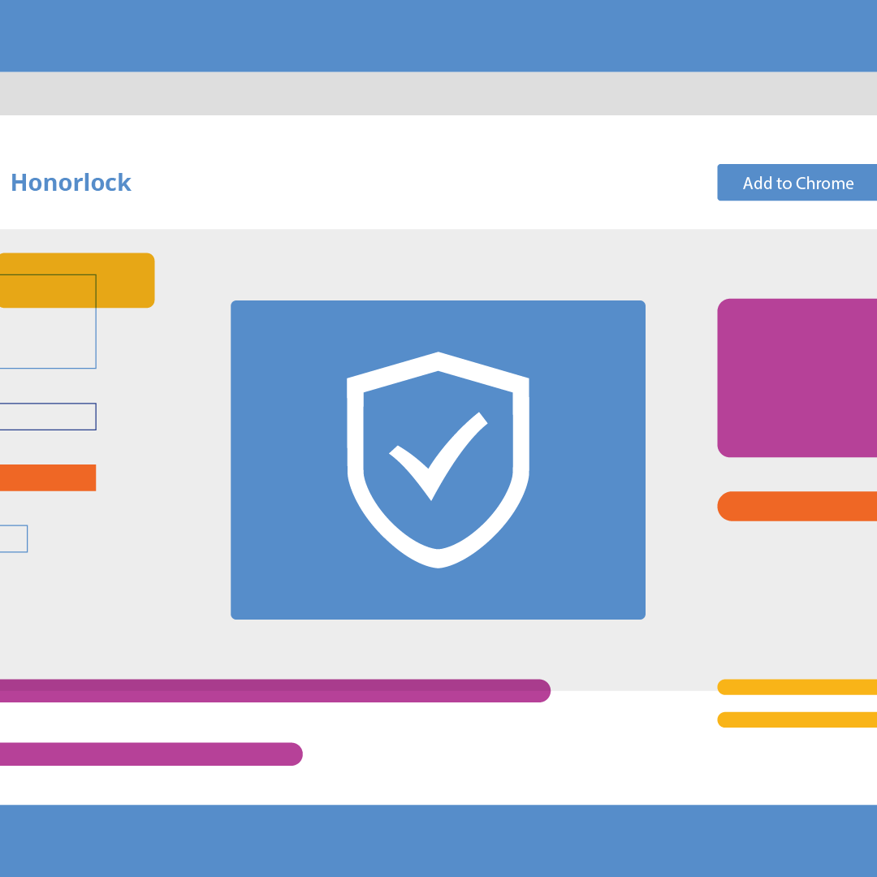
Designed to Protect Integrity
Finds Leaked Content
Search & Destroy™ identifies compromised exam questions and offers simple steps to protect integrity
Detects Devices
Detects when students try to search test questions during exams using a secondary device, such as a cell phone
Secures the Browser
BrowserGuard™ prevents and flags access to unauthorized websites and apps
Verifies Identity
Authenticates identity to ensure the person taking the test is the same as the person earning the degree
Blocks AI Tools
Block the use of AI, like ChatGPT, to prevent dishonesty before it starts
Notes:
Honorlock is designed to prevent student testing misconduct, protect our intellectual property, secure test content, and prevent exam content leaks.
Here are a few of the top exam security features:
Search & Destroy™ - Identifies compromised exam questions and offers simple steps to protect integrity
BrowserGuard™ - Prevents and flags access to unauthorized websites and applications, resizing the exam screen, and using keyboard shortcuts and functions and records the desktop for the duration of the exam
Cell Phone Detection - Detects when students try to search test questions during exams using a secondary device, such as a cell phone; then the proctor validates and clearly marks the violation
Blocks AI tools and extensions - Blocks any extensions running in the background of exams, prevents copy/paste, and secures the browser
Verifies student identity - Authenticates identity to ensure the person taking the test is the same as the person earning the degree

Slide 9

Accessibility Checklist | Yes
Is Honorlock full ADA compliant? | ✔
Does Honorlock support and integrate with assistive technology? | ✔
Does Honorlock have an updated Voluntary Product Accessibility Template? | ✔
Are instructors able to provide accommodations for specific students? | ✔
Honorlock’s Accessibility-First Approach
Notes:
Honorlock’s human involvement means they can make human decisions around accessibility.
Here are the key ways they meet accessibility standards:
They are fully ADA compliant
Honorlock can support a wide range of assistive technologies like screen readers, alternate keyboards, or graphic organizers
Honorlock undergoes a third-party accessibility test to build a well-informed Voluntary Product Accessibility Template (VPAT)
Instructors can set accommodations under Honorlock’s proctoring guidelines such as bathroom breaks, specific assistive devices, extended time limits, interpreters, multiple monitors, etc.

